Slide 1
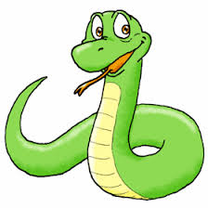

10. Spatial data processing
https://pcjericks.github.io/py-gdalogr-cookbook/
https://www.python.org/

Slide 2
Open Source RS/GIS modules
Spatial data are modeled as raster and vector data type
Spatial data can be accessed in Python through the use of different libraries
Libraries are collections of reusable bits of code
Libraries in Python are usually called modules. They can contain a variety of related things, including functions, constants, and classes.
GDAL (Geospatial Data Abstraction Library) and the OGR Simple Features Library are Open Source RS/GIS libraries that can access raster and vector data

Slide 3
Open Source RS/GIS modules
Development started by Frank Warmerdam in 1998. Now officially maintained by OSGEO.
OGR Simple Features Library
Vector data access
Part of GDAL
GDAL – Geospatial Data AbstractionLibrary
Raster data access
Used by commercial software like ArcGIS
Actually, C++ library, but Python bindings exist

Slide 4
Related modules
Numeric
Sophisticated array manipulation (extremely useful for raster data!)
This is the one we’ll be using in class
NumPy
Next generation of Numeric

Slide 5
Documentation
GDAL: http://www.gdal.org/, gdal.py,
gdalconst.py (in the fwtools/pymod folder)
OGR: http://www.gdal.org/ogr/, ogr.py
Numeric: http://numpy.scipy.org/#older_array
NumPy: http://numpy.scipy.org/

Slide 6
OGR
Supports many different vector formats
ESRI formats such as shapefiles, personal geodatabases and ArcSDE
Other software such as MapInfo, GRASS, Microstation
Open formats such as TIGER/Line, SDTS,GML, KML
Databases such as MySQL, PostgreSQL,Oracle Spatial, Informix, ODBC

Slide 7
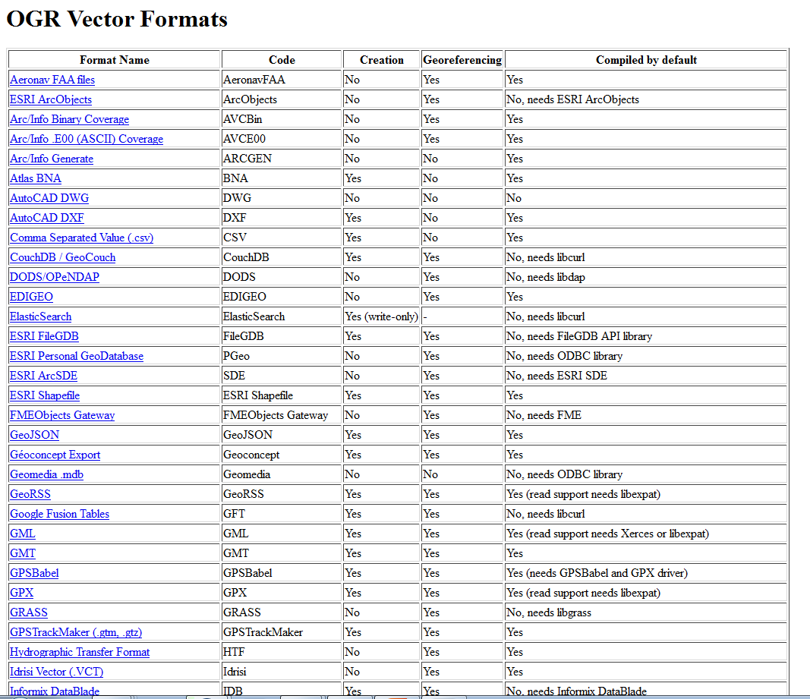

Slide 8
Class Overview
Geometry : The geometry classes (OGRGeometry, etc) encapsulate the OpenGIS model vector data as well as providing some geometry operations, and translation to/from well known binary(wkb) and text(wkt) format. A geometry includes a spatial reference system (projection).
Spatial Reference : An OGRSpatialReference encapsulates the definition of a projection and datum.
Feature : The OGRFeature encapsulates the definition of a whole feature, that is a geometry and a set of attributes.
Feature Class Definition : The OGRFeatureDefn class captures the schema (set of field definitions) for a group of related features (normally a whole layer).

Slide 9
Class Overview
Layer : OGRLayer is an abstract base class represent a layer of features in an GDALDataset.
Dataset : A GDALDataset is an abstract base class representing a file or database containing one or more OGRLayer objects.
Drivers : A GDALDriver represents a translator for a specific format, opening GDALDataset objects. All available drivers are managed by the GDALDriverManager.

Slide 10
Reading and Writing Vector Data with OGR: Importing OGR
With FWTools:
import ogr
With an OSGeo distribution:
from osgeo import ogr
• Handle both cases like this:
try:
from osgeo import ogr
except:
import ogr

Slide 11
OGR data drivers
A driver is an object that knows how to interact with a certain data type (such as a shapefile)
Need an appropriate driver in order to read or write data (need it explicitly for write)

Slide 12
OGR data drivers
Might as well grab the driver for read operations so it is available for writing
1. Import the OGR module
2. Use ogr.GetDriverByName(<driver_code>)
import ogr
driver = ogr.GetDriverByName('ESRI Shapefile')
import ogr
cnt = ogr.GetDriverCount()
for i in range(cnt):
driver = ogr.GetDriver(i)
print (driver.GetName())

Slide 13
Opening a DataSource
The Driver Open() method returns a DataSource object
Open(<filename>, <update>)
where <update> is 0 for read-only, 1 for writeable
fn = 'f:/data/classes/python/data/sites.shp'
dataSource = driver.Open(fn, 0)
if dataSource is None:
print ('Could not open ' + fn)
sys.exit(1) #exit with an error code

Slide 14
Detour: Working directory
Usually need to specify entire path for filenames
Instead, set working directory with os.chdir(<directory_path>)
import ogr, sys, os
os.chdir('f:/data/classes/python/data')
driver = ogr.GetDriverByName('ESRI Shapefile')
dataSource = driver.Open('sites.shp', 0)

Slide 15
Opening a layer (shapefile)
Use GetLayer(<index>) on a DataSource to get a Layer object
<index> is always 0 and optional for shapefiles
<index> is useful for other data types such as GML, TIGER
layer = dataSource.GetLayer()
layer = dataSource.GetLayer(0)

Slide 16
Getting info about the layer
Get the number of features in the layer
numFeatures = layer.GetFeatureCount()
print ('Feature count: ' + str(numFeatures))
print ('Feature count:', numFeatures)
Get the extent as a tuple (sort of a nonmodifiable list)
extent = layer.GetExtent()
print ('Extent:', extent)
print ('UL:', extent[0], extent[3])
print ('LR:', extent[1], extent[2])

Slide 17
Getting features
If knows the FID (offset) of a feature, can use GetFeature(<index>) on the Layer
feature = layer.GetFeature(0)
Or can loop through all of the features
feature = layer.GetNextFeature()
while feature:
# do something here
feature = layer.GetNextFeature()
layer.ResetReading() #need if looping again from first feature

Slide 18
Getting a feature’s attributes
Feature objects have a GetField(<name>) method which returns the value of that attribute field
There are variations, such as
GetFieldAsString(<name>) and
GetFieldAsInteger(<name>)
id = feature.GetField('id')
id = feature.GetFieldAsString('id')

Slide 19
Getting a feature’s geometry
Feature objects have a method called GetGeometryRef() which returns a Geometry object (could be Point, Polygon, etc)
Point objects have GetX() GetY() methods
geometry = feature.GetGeometryRef()
x = geometry.GetX()
y = geometry.GetY()

Slide 20
Destroying objects
For memory management purposes we need to make sure that we get rid of things such as features when done with them
feature.Destroy()
Also need to close DataSource objects when done with them
dataSource.Destroy()

Slide 21
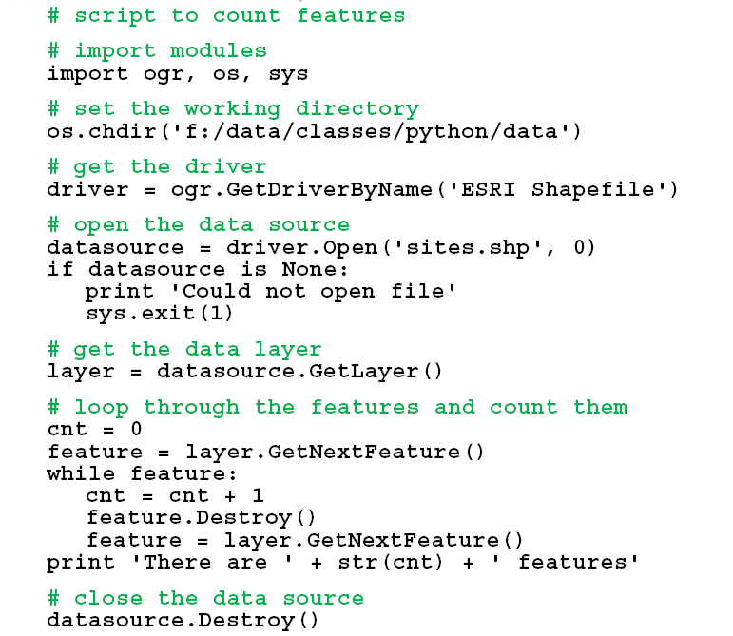
Counting features

Slide 22
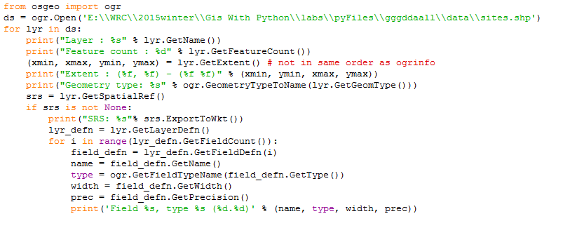
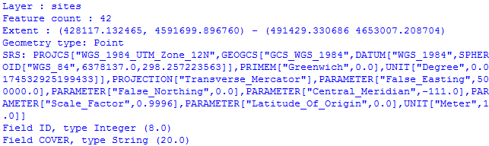
Getting information :number of features, spatial extent in (xmin, ymin) – (xmax, ymax) format, coordinate system, list of attributes with their name, type and width.precision

Slide 23
Exercise (assignment)
Read coordinates and attributes from a shapefile
Loop through the points in sites.shp
Write out id, x & y coordinates, and cover type for each point to a text file, one point per line
Hint: The two attribute fields in the shapefile are called "id" and "cover“
: You can print more than one item on a line by separating them with commas, like this: print id, x, y, cover
Mail source code and the output text file

Slide 24
Writing data
1. (a) Get or (b) create a writeable layer
2. Add fields if necessary
3. Create a feature
4. Populate the feature
5. Add the feature to the layer
6. Close the layer

Slide 25
1. (a) Getting a writeable layer
Open an existing DataSource for writing and get the layer out of it
fn = 'f:/data/classes/python/data/sites.shp'
dataSource = driver.Open(fn, 1)
if dataSource is None:
print 'Could not open ' + fn
sys.exit(1) #exit with an error code
layer = dataSource.GetLayer(0)

Slide 26
1. (b) Creating a writeable layer
Create a new DataSource and Layer
I. CreateDataSource(<filename>) on a Driver object – the file cannot already exist!
II. CreateLayer(<name>,geom_type=<OGRwkbGeometryType>, [srs]) on a DataSource object
ds = driver.CreateDataSource('test.shp')
layer = ds.CreateLayer('test', geom_type=ogr.wkbPoint)

Slide 27
1. (b). (I) Checking if a datasource exists
• Use the exists(<filename>) method in the os.path module
• Use DeleteDataSource(<filename>) on a Driver object to delete it (this causes an error if the file does not exist)
import os
if os.path.exists('test.shp'):
driver.DeleteDataSource('test.shp')

Slide 28
2. Adding fields (a)Getting FieldDefn
• Shapefiles need at least one attribute field
• Need a FieldDefn object first
• Copy one from an existing feature with
GetFieldDefnRef(<field_index>) or
GetFieldDefnRef(<field_name>)
fieldDefn = feature.GetFieldDefnRef(0) #or
fieldDefn = feature.GetFieldDefnRef('id')

Slide 29
2. (b) Creating FieldDefn and Creat fields
• create a new FieldDefn with FieldDefn(<field_name>, <OGRFieldType>),
where the field name has a 12-character limit
fldDef = ogr.FieldDefn('id', ogr.OFTInteger)
• If it is a string field, set the width
fieldDefn = ogr.FieldDefn('id', ogr.OFTString)
fieldDefn.SetWidth(4)
• Now create a field on the layer using the FieldDefn object and CreateField(<FieldDefn>)
layer.CreateField(fieldDefn)

Slide 30
3. Creating new features
• Need a FeatureDefn object first
• Get it from the layer after adding any fields
featureDefn = layer.GetLayerDefn()
• Now use the FeatureDefn object to create a new Feature object
feature = ogr.Feature(featureDefn)

Slide 31
3. Creating new features
• Set the geometry for the new feature
point = ogr.Geometry(ogr.wkbPoint)
point.SetPoint(0,10,10)
feature.SetGeometry(point)
• Set the attributes with SetField(<name>,<value>)
feature.SetField('id', 23) # 4. populate the feature
• Write the feature to the layer
layer.CreateFeature(feature) # 5. add feature to the layer
• Make sure to close the DataSource with Destroy() at the end so things get written

Slide 32
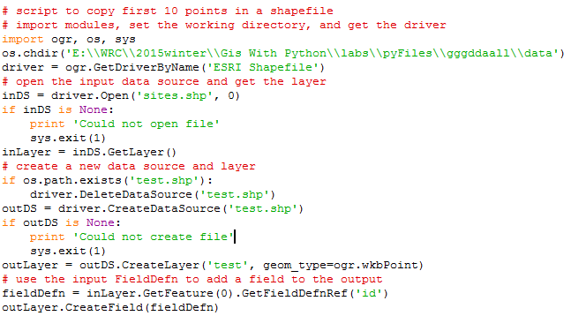
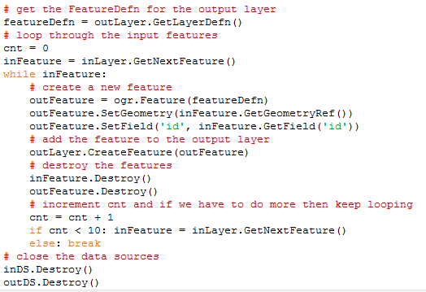
Exercise example

Slide 33
Exercise example
# script to copy first 10 points in a shapefile
# import modules, set the working directory, and get the driver
import ogr, os, sys
os.chdir('E:\\WRC\\2015winter\\Gis With Python\\labs\\data')
driver = ogr.GetDriverByName('ESRI Shapefile')
# open the input data source and get the layer
inDS = driver.Open('sites.shp', 0)
if inDS is None:
print 'Could not open file'
sys.exit(1)
inLayer = inDS.GetLayer()
# create a new data source and layer
if os.path.exists('test.shp'):
driver.DeleteDataSource('test.shp')
outDS = driver.CreateDataSource('test.shp')
if outDS is None:
print 'Could not create file'
sys.exit(1)
outLayer = outDS.CreateLayer('test', geom_type=ogr.wkbPoint)
# use the input FieldDefn to add a field to the output
fieldDefn = inLayer.GetFeature(0).GetFieldDefnRef('id')
outLayer.CreateField(fieldDefn)
# get the FeatureDefn for the output layer
featureDefn = outLayer.GetLayerDefn()
# loop through the input features
cnt = 0
inFeature = inLayer.GetNextFeature()
while inFeature:
# create a new feature
outFeature = ogr.Feature(featureDefn)
outFeature.SetGeometry(inFeature.GetGeometryRef())
outFeature.SetField('id', inFeature.GetField('id'))
# add the feature to the output layer
outLayer.CreateFeature(outFeature)
# destroy the features
inFeature.Destroy()
outFeature.Destroy()
# increment cnt and if we have to do more then keep looping
cnt = cnt + 1
if cnt < 10: inFeature = inLayer.GetNextFeature()
else: break
# close the data sources
inDS.Destroy()
outDS.Destroy()

Slide 34
Exercise(assignment)
• Copy selected features from one shapefile to another
• Create a new point shapefile and add an ID field
• Loop through the points in sites.shp
• If the cover attribute for a point is ‘trees’ then write that point out to the new shapefile
• Mail the source code and a screenshot of the new shapefile being displayed

Slide 35
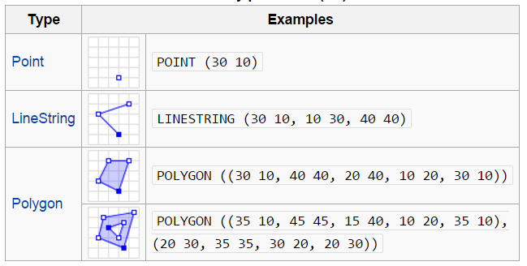
Geometry
Geometry : The geometry classes (OGRGeometry, etc) encapsulate the OpenGIS model vector data as well as providing some geometry operations, and translation to/from well known binary(wkb) and text(wkt) format. A geometry includes a spatial reference system (projection).
Types of geometry include
OGRPoint, OGRLineString, OGRPolygon, OGRGeometryCollection, OGRMultiPolygon,
OGRMultiPoint, and OGRMultiLineString.

Slide 36
Geometry
OGC Simple Features
○ Point
○ LineString
○ Polygon
○ MultiPoint
○ MultiLineString
○ MultiPolygon
○ GeometryCollection
Creating a new Geometry
Create an empty Geometry object with ogr.Geometry(<OGRwkbGeometryType>)
Define what the geometry is in a different way for each type (point, line, polygon, etc.)

Slide 37
Creating points
Use AddPoint( <x>, <y>, [<z>]) to set coordinates. The height value <z> is optional and defaults to 0
point = ogr.Geometry(ogr.wkbPoint)
point.AddPoint(10,20)
from osgeo import ogr
point = ogr.Geometry(ogr.wkbPoint)
point.AddPoint(1198054.34, 648493.09)
print point
POINT (1198054.34 648493.09 0)

Slide 38
Creating lines
Add new vertices to the line with AddPoint(<x>, <y>, [<z>])
Change the coordinates of a vertex with SetPoint(<index>, <x>, <y>, [<z>])
where <index> is the index of the vertex to change
line = ogr.Geometry(ogr.wkbLineString)
line.AddPoint(10,10)
line.AddPoint(20,20)
line.SetPoint(0,30,30) #(10,10) -> (30,30)
print line

Slide 39
Creating lines
To get the number of vertices in a line use GetPointCount()
print line.GetPointCount()
To get the x,y coordinates for a specific vertex use GetX(<vertex_index>) and GetY(<vertex_index>)
print line.GetX(0)
print line.GetY(0)

Slide 40
Creating polygons
Must create rings first and then add them to the polygon later
To make a ring, create an empty ring Geometry and then use AddPoint(<x>,<y>) to add vertices
ring = ogr.Geometry(ogr.wkbLinearRing)
ring.AddPoint(0,0)
ring.AddPoint(100,0)
ring.AddPoint(100,100)
ring.AddPoint(0,100)
To close the ring, use CloseRings() or make the last vertex the same as the first
ring.CloseRings()
ring.AddPoint(0,0)

Slide 41
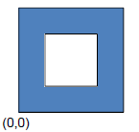
Creating polygons
outring = ogr.Geometry(ogr.wkbLinearRing)
outring.AddPoint(0,0)
outring.AddPoint(100,0)
outring.AddPoint(100,100)
outring.AddPoint(0,100)
outring.AddPoint(0,0)
inring = ogr.Geometry(ogr.wkbLinearRing)
inring.AddPoint(25,25)
inring.AddPoint(75,25)
inring.AddPoint(75,75)
inring.AddPoint(25,75)
inring.CloseRings()

Slide 42
Creating polygons
Now make the polygon and add the rings with AddGeometry(<geometry>)
polygon = ogr.Geometry(ogr.wkbPolygon)
polygon.AddGeometry(outring)
polygon.AddGeometry(inring)
Get the number of rings in a polygon with GetGeometryCount()
print polygon.GetGeometryCount()

Slide 43
Creating polygons
Get a ring object from a polygon with GetGeometryRef(<ring_index>); indices are the same order you added them to thepolygon
outring = polygon.GetGeometryRef(0)
inring = polygon.GetGeometryRef(1)
• Get the number of vertices in a ring and the coordinates of those vertices as inring.GetPointCount(), inring.GetX(<vertex_index>) and inring.GetY(<vertex_index>)

Slide 44
from osgeo import ogr
# Create outer ring
outRing = ogr.Geometry(ogr.wkbLinearRing)
outRing.AddPoint(1154115.274565847, 686419.4442701361)
outRing.AddPoint(1154115.274565847, 653118.2574374934)
outRing.AddPoint(1165678.1866605144, 653118.2574374934)
outRing.AddPoint(1165678.1866605144, 686419.4442701361)
outRing.AddPoint(1154115.274565847, 686419.4442701361)
# Create inner ring
innerRing = ogr.Geometry(ogr.wkbLinearRing)
innerRing.AddPoint(1149490.1097279799, 691044.6091080031)
innerRing.AddPoint(1149490.1097279799, 648030.5761158396)
innerRing.AddPoint(1191579.1097525698, 648030.5761158396)
innerRing.AddPoint(1191579.1097525698, 691044.6091080031)
innerRing.AddPoint(1149490.1097279799, 691044.6091080031)
# Create polygon
poly = ogr.Geometry(ogr.wkbPolygon)
poly.AddGeometry(outRing)
poly.AddGeometry(innerRing)
#count vertices in ring and Get X of first vertex
outring=poly.GetGeometryRef(0)
print outring.GetPointCount()
print outring.GetX(0)
print poly.ExportToWkt()
5
1154115.27457
POLYGON ((1154115.2745658469 686419.44427013607 0,1154115.2745658469 653118.25743749342 0,1165678.1866605144 653118.25743749342 0,1165678.1866605144 686419.44427013607 0,1154115.2745658469 686419.44427013607 0),(1149490.1097279799 691044.60910800309 0,1149490.1097279799 648030.57611583965 0,1191579.1097525698 648030.57611583965 0,1191579.1097525698 691044.60910800309 0,1149490.1097279799 691044.60910800309 0))

Slide 45
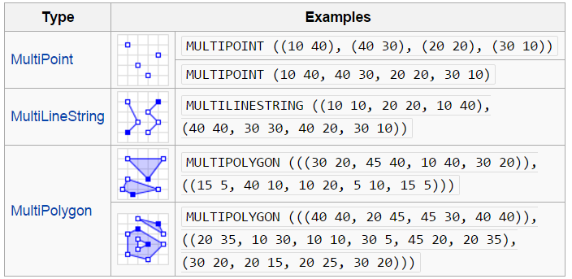
Multi Geometries
MultiPoint, MultiLineString, MultiPolygon…
Create a geometry and then add it to the multi-version with AddGeometry(<geom>)

Slide 46
Create a MultiPoint
from osgeo import ogr
multipoint = ogr.Geometry(ogr.wkbMultiPoint)
point1 = ogr.Geometry(ogr.wkbPoint)
point1.AddPoint(1251243.7361610543, 598078.7958668759)
multipoint.AddGeometry(point1)
point2 = ogr.Geometry(ogr.wkbPoint)
point2.AddPoint(1240605.8570339603, 601778.9277371694)
multipoint.AddGeometry(point2)
point3 = ogr.Geometry(ogr.wkbPoint)
point3.AddPoint(1250318.7031934808, 606404.0925750365)
multipoint.AddGeometry(point3)
print multipoint.ExportToWkt()

Slide 47
Create a MultiLineString
from osgeo import ogr
multiline = ogr.Geometry(ogr.wkbMultiLineString)
line1 = ogr.Geometry(ogr.wkbLineString)
line1.AddPoint(1214242.4174581182, 617041.9717021306)
line1.AddPoint(1234593.142744733, 629529.9167643716)
multiline.AddGeometry(line1)
line1 = ogr.Geometry(ogr.wkbLineString)
line1.AddPoint(1184641.3624957693, 626754.8178616514)
line1.AddPoint(1219792.6152635587, 606866.6090588232)
multiline.AddGeometry(line1)
print multiline.ExportToWkt()

Slide 48
Create a MultiPolygon
from osgeo import ogr
multipolygon = ogr.Geometry(ogr.wkbMultiPolygon)
# Create ring #1
ring1 = ogr.Geometry(ogr.wkbLinearRing)
ring1.AddPoint(1204067.0548148106, 634617.5980860253)
ring1.AddPoint(1204067.0548148106, 620742.1035724243)
ring1.AddPoint(1215167.4504256917, 620742.1035724243)
ring1.AddPoint(1215167.4504256917, 634617.5980860253)
ring1.AddPoint(1204067.0548148106, 634617.5980860253)
# Create polygon #1
poly1 = ogr.Geometry(ogr.wkbPolygon)
poly1.AddGeometry(ring1)
multipolygon.AddGeometry(poly1)
# Create ring #2
ring2 = ogr.Geometry(ogr.wkbLinearRing)
ring2.AddPoint(1179553.6811741155, 647105.5431482664)
ring2.AddPoint(1179553.6811741155, 626292.3013778647)
ring2.AddPoint(1194354.20865529, 626292.3013778647)
ring2.AddPoint(1194354.20865529, 647105.5431482664)
ring2.AddPoint(1179553.6811741155, 647105.5431482664)
# Create polygon #2
poly2 = ogr.Geometry(ogr.wkbPolygon)
poly2.AddGeometry(ring2)
multipolygon.AddGeometry(poly2)
print multipolygon.ExportToWkt()

Slide 49
Create a GeometryCollection
from osgeo import ogr
# Create a geometry collection
geomcol = ogr.Geometry(ogr.wkbGeometryCollection)
# Add a point
point = ogr.Geometry(ogr.wkbPoint)
point.AddPoint(‐122.23, 47.09)
geomcol.AddGeometry(point)
# Add a line
line = ogr.Geometry(ogr.wkbLineString)
line.AddPoint(‐122.60, 47.14)
line.AddPoint(‐122.48, 47.23)
geomcol.AddGeometry(line)
print geomcol.ExportToWkt()
Do not destroy geometries that come from an existing feature. Destroy geometries that are created during script execution

Slide 50
Exercise(example)
# script to add a point to a new shapefile
# import modules and set the working directory
import ogr, os, sys
os.chdir('E:\\WRC\\data')
# get the driver
driver = ogr.GetDriverByName('ESRI Shapefile')
# create a new data source and layer
if os.path.exists('test.shp'):
driver.DeleteDataSource('test.shp')
ds = driver.CreateDataSource('test.shp')
if ds is None:
print 'Could not create file'
sys.exit(1)
layer = ds.CreateLayer('test', geom_type=ogr.wkbPoint)
# add an id field to the output
fieldDefn = ogr.FieldDefn('id', ogr.OFTInteger)
layer.CreateField(fieldDefn)
# create a new point object
point = ogr.Geometry(ogr.wkbPoint)
point.AddPoint(150, 75)
# get the FeatureDefn for the output layer
featureDefn = layer.GetLayerDefn()
# create a new feature
feature = ogr.Feature(featureDefn)
feature.SetGeometry(point)
feature.SetField('id', 1)
# add the feature to the output layer
layer.CreateFeature(feature)
# destroy the geometry and feature and close the data source
point.Destroy()
feature.Destroy()
ds.Destroy()

Slide 51
Projections
The OGRSpatialReference class is intended to store an OpenGIS Spatial Reference System definition.
Currently local, geographic and projected coordinate systems are supported
The spatial coordinate system data model is inherited from the OpenGIS Well Known Text format

Slide 52
Projections
Lots of different ways to specify projections
• Well Known Text (WKT):
http://en.wikipedia.org/wiki/Well-known_text
• PROJ.4: www.remotesensing.org/geotiff/proj_list/
• EPSG (European Petroleum Survey Group): see
epsg file in your FWTools2.x.x/proj_lib directory
• USGS: see importFromUSGS() description at
www.gdal.org/ogr/classOGRSpatialReference.html
• ESRI .prj (import only), PCI software, XML

Slide 53
Projections
ESRI .prj
PROJCS["WGS_1984_UTM_Zone_12N",GEOGCS["GCS_WGS_1984",DATUM["D_
WGS_1984",SPHEROID["WGS_1984",6378137,298.257223563]],PRIMEM["
Greenwich",0],UNIT["Degree",0.017453292519943295]],PROJECTION[
"Transverse_Mercator"],PARAMETER["False_Easting",500000],PARAM
ETER["False_Northing",0],PARAMETER["Central_Meridian",-
111],PARAMETER["Scale_Factor",0.9996],PARAMETER["Latitude_Of_O
rigin",0],UNIT["Meter",1]]
WKT
PROJCS["UTM Zone 12, Northern
Hemisphere",GEOGCS["WGS_1984",DATUM["WGS_1984",SPHEROID["WGS
84",6378137,298.2572235630016],TOWGS84[0,0,0,0,0,0,0]],PRIMEM[
"Greenwich",0],UNIT["degree",0.0174532925199433],AUTHORITY["EP
SG","4326"]],PROJECTION["Transverse_Mercator"],PARAMETER["lati
tude_of_origin",0],PARAMETER["central_meridian",-
111],PARAMETER["scale_factor",0.9996],PARAMETER["false_easting
",500000],PARAMETER["false_northing",0],UNIT["Meter",1],AUTHOR
ITY["EPSG","32612"]]

Slide 54
Projections
Pretty WKT
PROJCS["UTM Zone 12, Northern Hemisphere",
GEOGCS["WGS_1984",
DATUM["WGS_1984",
SPHEROID["WGS 84",6378137,298.2572235630016],
TOWGS84[0,0,0,0,0,0,0]],
PRIMEM["Greenwich",0],
UNIT["degree",0.0174532925199433],
AUTHORITY["EPSG","4326"]],
PROJECTION["Transverse_Mercator"],
PARAMETER["latitude_of_origin",0],
PARAMETER["central_meridian",-111],
PARAMETER["scale_factor",0.9996],
PARAMETER["false_easting",500000],
PARAMETER["false_northing",0],
UNIT["Meter",1],
AUTHORITY["EPSG","32612"]]

Slide 55
Projections
EPSG
32612
Proj.4
+proj=utm +zone=12 +ellps=WGS84 +datum=WGS84 +units=m +no_defs
USGS
(1, 12, (0.0, 0.0, 0.0, 0.0, 0.0, 0.0, 0.0, 0.0, 0.0, 0.0,
0.0, 0.0, 0.0, 0.0, 0.0), 12)
PCI
('UTM 12 D000', 'METRE', (0.0, 0.0, 0.0, 0.0, 0.0, 0.0,
0.0, 0.0, 0.0, 0.0, 0.0, 0.0, 0.0, 0.0, 0.0, 0.0, 0.0))

Slide 56
Getting a layer's projection
• If a data set has projection information stored with it (for example, a .prj file with a shapefile)
spatialRef = layer.GetSpatialRef()
• If no projection information with the data, then GetSpatialRef() returns None
• Can also get it from a geometry object:
spatialRef = geom.GetSpatialReference()

Slide 57
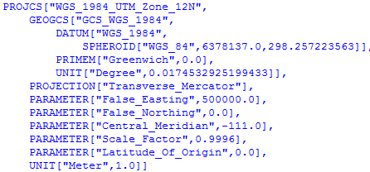
Getting a layer's projection
from osgeo import ogr, osr
driver = ogr.GetDriverByName('ESRI Shapefile')
dataset = driver.Open(r'E:\WRC\data\sites.shp')
# from Layer
layer = dataset.GetLayer()
spatialRef = layer.GetSpatialRef()
print spatialRef
# from Geometry
feature = layer.GetNextFeature()
geom = feature.GetGeometryRef()
spatialRef = geom.GetSpatialReference()
print spatialRef

Slide 58
Creating a new projection
1. Import osr
2. Create an empty SpatialReference object with osr.SpatialReference()
3. Use one of the import methods (next slide) to import projection information into
the SpatialReference object
from osgeo import osr
spatialRef = osr.SpatialReference()
spatialRef.ImportFromEPSG(32612) # from EPSG
• ImportFromWkt(<wkt>)
• ImportFromEPSG(<epsg>)
• ImportFromProj4(<proj4>)
• ImportFromESRI(<proj_lines>)
• ImportFromPCI(<proj>, <units>,<parms>)
• ImportFromUSGS(<proj_code>, <zone>)
• ImportFromXML(<xml>)
or
spatialRef.ImportFromProj4('+proj=utm
+zone=12 +ellps=WGS84 +datum=WGS84
+units=m +no_defs')

Slide 59
Exporting a projection
These methods will return strings
• ExportToWkt()
• ExportToPrettyWkt()
• ExportToProj4()
• ExportToPCI()
• ExportToUSGS()
• ExportToXML()
from osgeo import ogr, osr
driver = ogr.GetDriverByName('ESRI Shapefile')
dataset = driver.Open(r'E:\WRC\data\sites.shp')
# from Layer
layer = dataset.GetLayer()
spatialRef = layer.GetSpatialRef()
#check any one of the export
print spatialRef.ExportToWkt()
print spatialRef.ExportToPrettyWkt()
print spatialRef.ExportToPCI()
print spatialRef.ExportToUSGS()
print spatialRef.ExportToXML()
print spatialRef

Slide 60
Creating an ESRI .prj file
from osgeo import ogr, osr
spatialRef = osr.SpatialReference()
spatialRef.ImportFromEPSG(26912)
spatialRef.MorphToESRI()
file = open('yourshpfile.prj', 'w')
file.write(spatialRef.ExportToWkt())
file.close()

Slide 61
Projecting a geometry
1. Create a CoordinateTransformation
1. Get the SpatialReference for the source
2. Get the SpatialReference for the target
3. Create the CoordinateTransformation with
osr.CoordinateTransformation(<sourceSpatialRef>,<targetSpatialRef>)
2. Use Transform(<CoordTransform> )on the geometry object
In order to project an entire DataSource, need to project one geometry at a time

Slide 62
Projecting a geometry
from osgeo import ogr
from osgeo import osr
source = osr.SpatialReference()
source.ImportFromEPSG(2927)
target = osr.SpatialReference()
target.ImportFromEPSG(4326)
transform = osr.CoordinateTransformation(source, target)
point = ogr.CreateGeometryFromWkt("POINT (1120351.57 741921.42)")
point.Transform(transform)
print point.ExportToWkt()

Slide 63
Projecting a geometry
import ogr, osr, os
os.chdir(r'E:\WRC\data')
driver = ogr.GetDriverByName('ESRI Shapefile')
dataset = driver.Open('Settlements.shp')
layer = dataset.GetLayer()
feature = layer.GetNextFeature()
geom = feature.GetGeometryRef()
print geom.GetX(), geom.GetY()
geoSR = osr.SpatialReference()
geoSR.ImportFromEPSG(4326) # unprojected WGS84
utmSR =osr.SpatialReference()
utmSR.ImportFromEPSG(32645) # UTM 45N WGS84
coordTrans =osr.CoordinateTransformation(geoSR, utmSR)
geom.Transform(coordTrans)
print geom.GetX(), geom. GetY()
87.6139831543 27.5187206268
560635.126486 3044040.56118

Slide 64
Exercise (try)
Reproject a shapefile
• Create a new point shapefile
• Loop through the points in Settlements.shp, reproject each one, and write it out to the new shapefile
• Go from EPSG 4326 (unprojected WGS84) to EPSG 32645 (UTM 45N WGS84)

